Slide 1
MKE Mobile 2020 Refresh
Intuitive ▪ easy ▪ effective

Slide 2
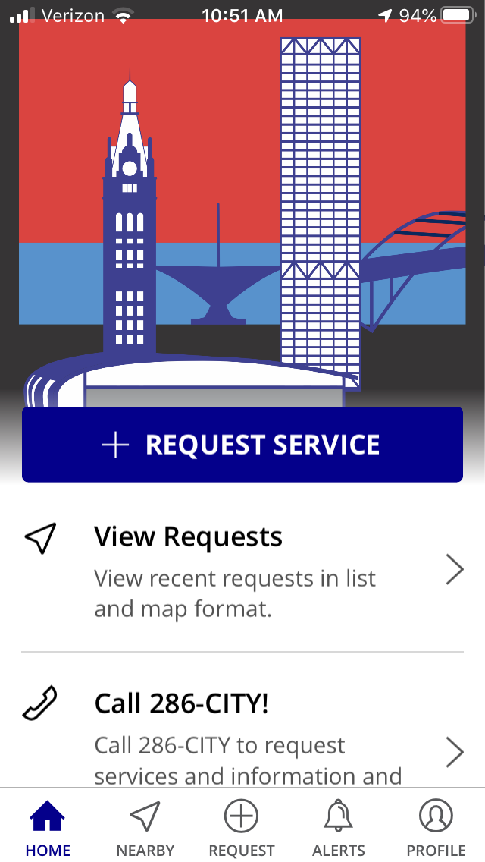
Available now
Search MKE Mobile Action on Apple App Store & Google Play Store

Slide 3
The home screen
Scroll down to see all of the widgets that take you to...
requests you can make
currently-processing requests
buttons to dial 286-CITY and other hotlines

Slide 4
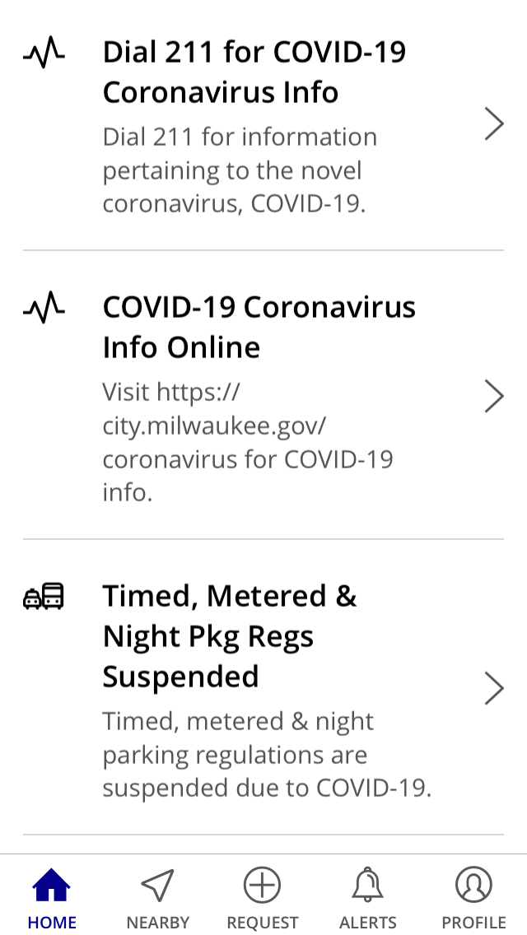
The home screen
Scroll down to see all of the widgets that take you to...
requests you can make
currently-processing requests
buttons to dial 286-CITY and other hotlines

Slide 5
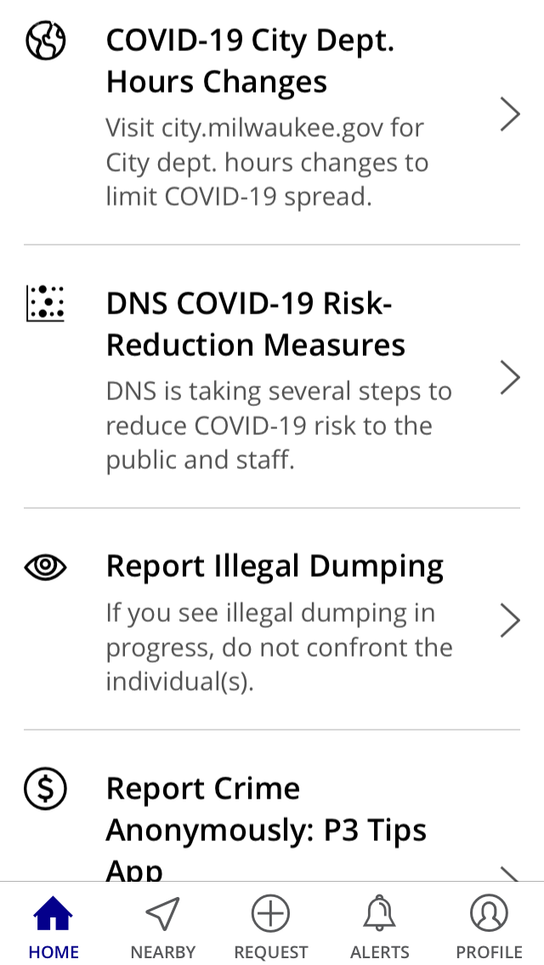
The home screen
Scroll down to see all of the widgets that take you to...
requests you can make
currently-processing requests
buttons to dial 286-CITY and other hotlines

Slide 6
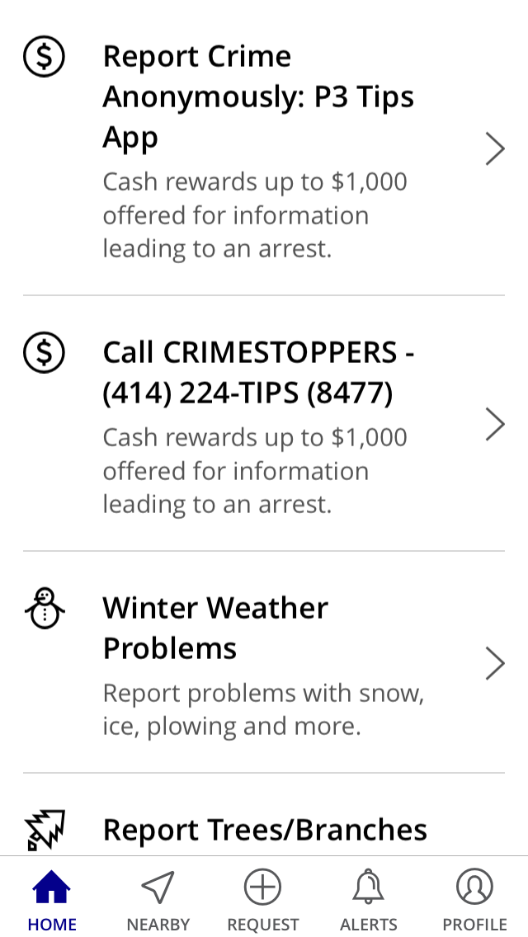
The home screen
Scroll down to see all of the widgets that take you to...
requests you can make
currently-processing requests
buttons to dial 286-CITY and other hotlines

Slide 7
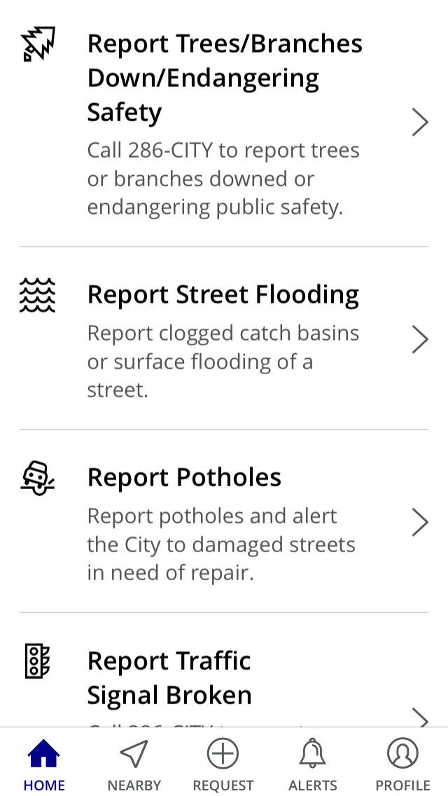
The home screen
Scroll down to see all of the widgets that take you to...
requests you can make
currently-processing requests
buttons to dial 286-CITY and other hotlines

Slide 8
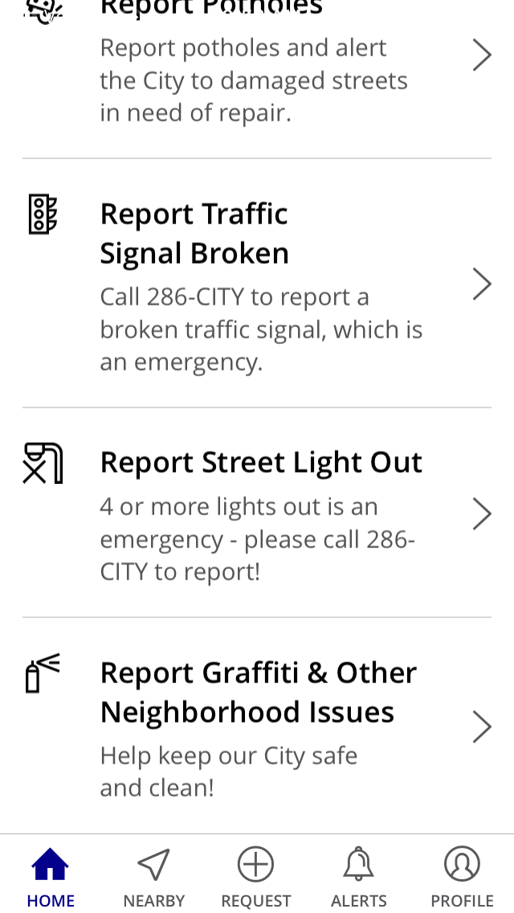
The home screen
Scroll down to see all of the widgets that take you to...
requests you can make
currently-processing requests
buttons to dial 286-CITY and other hotlines

Slide 9
Tap +Request Service
Scroll down to see all of the categories to select the category of request that suits your needs or...

Slide 10
Tap +Request Service
Scroll down to see all of the categories to select the category of request that suits your needs or...

Slide 11
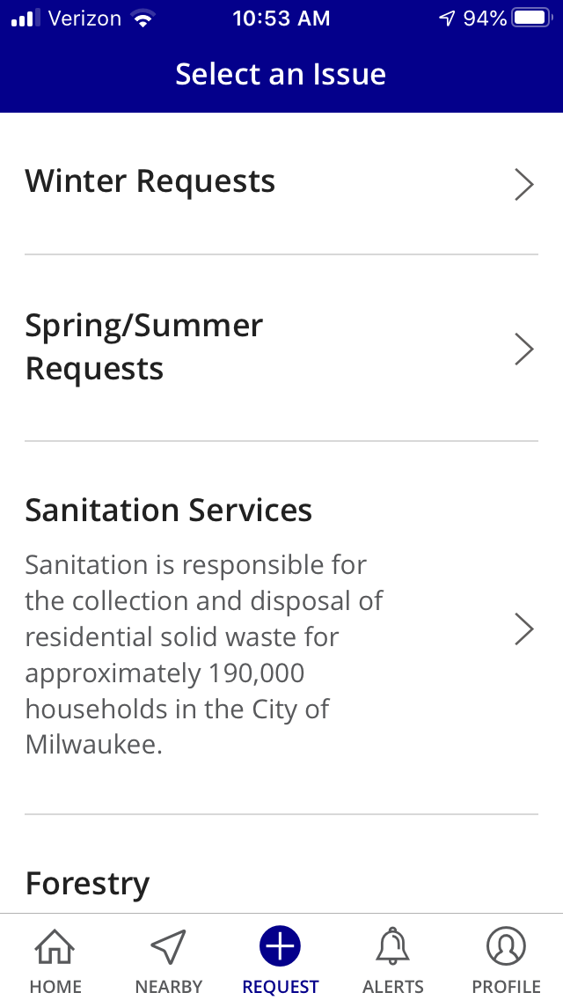
Tap +Request Service
Scroll down to see all of the categories to select the category of request that suits your needs or...

Slide 12
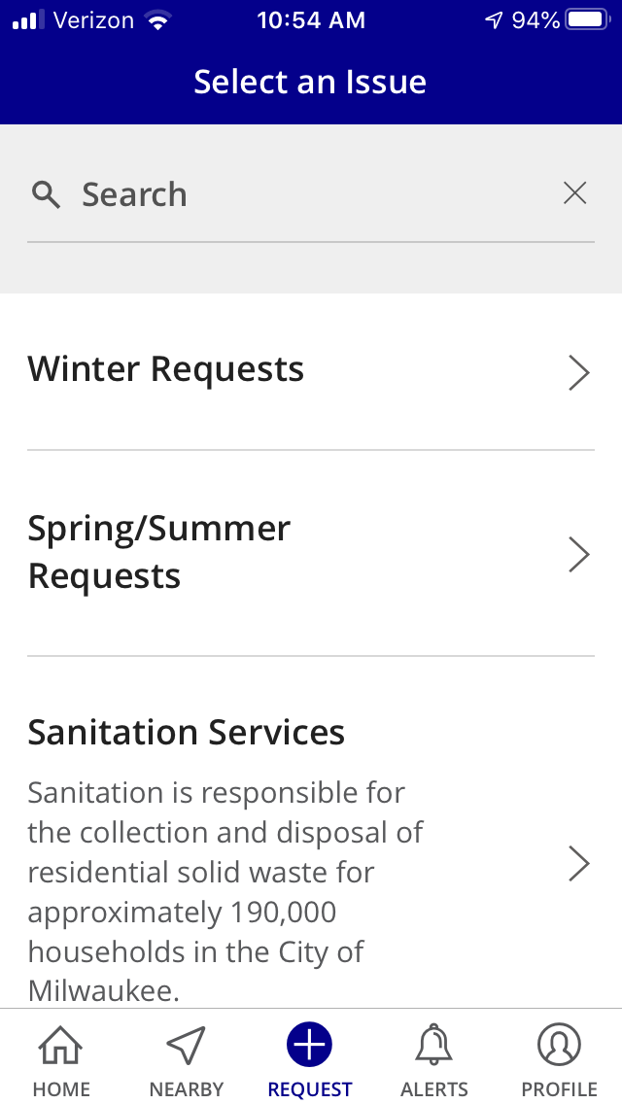
Tap +Request Service
...instead of scrolling down, PULL DOWN at the top to reveal the SEARCH bar!
Key words get you the request types you want to enter.

Slide 13
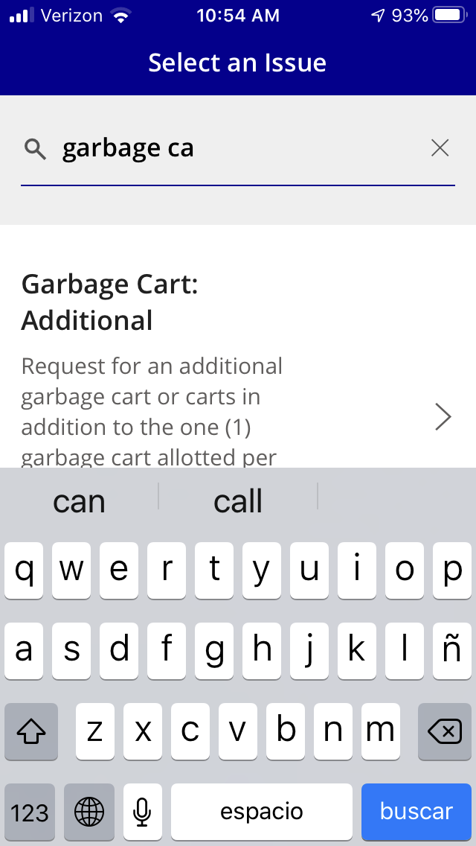
Tap +Request Service
...instead of scrolling down, PULL DOWN at the top to reveal the SEARCH bar!
Key words get you the request types you want to enter.

Slide 14
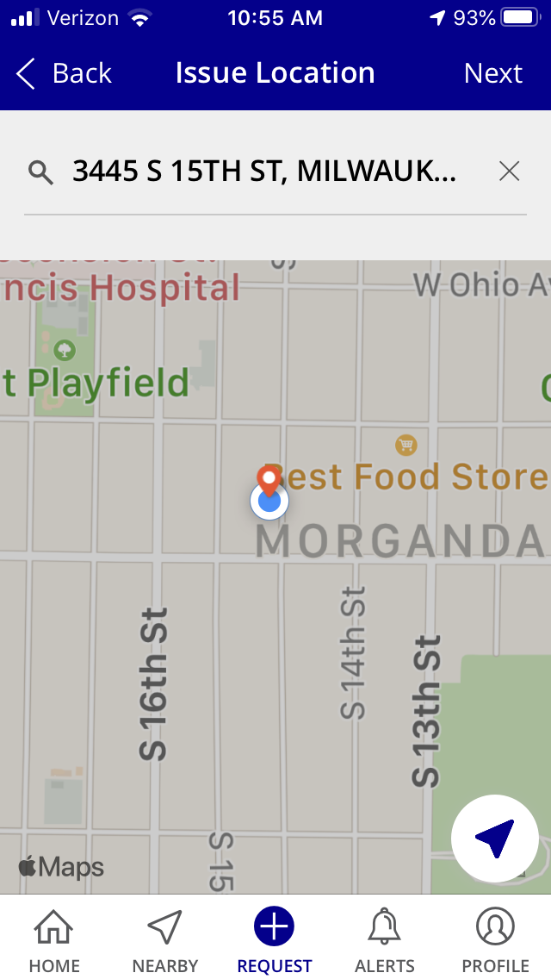
Tap +Request Service
Select the type of request desired and then simply complete the fields to enter the information needed for the City to fulfill the request.
Enable location services for the app to be able to pinpoint your location for an issue – or you can enter a location or drag the map pin to pinpoint the location.

Slide 15
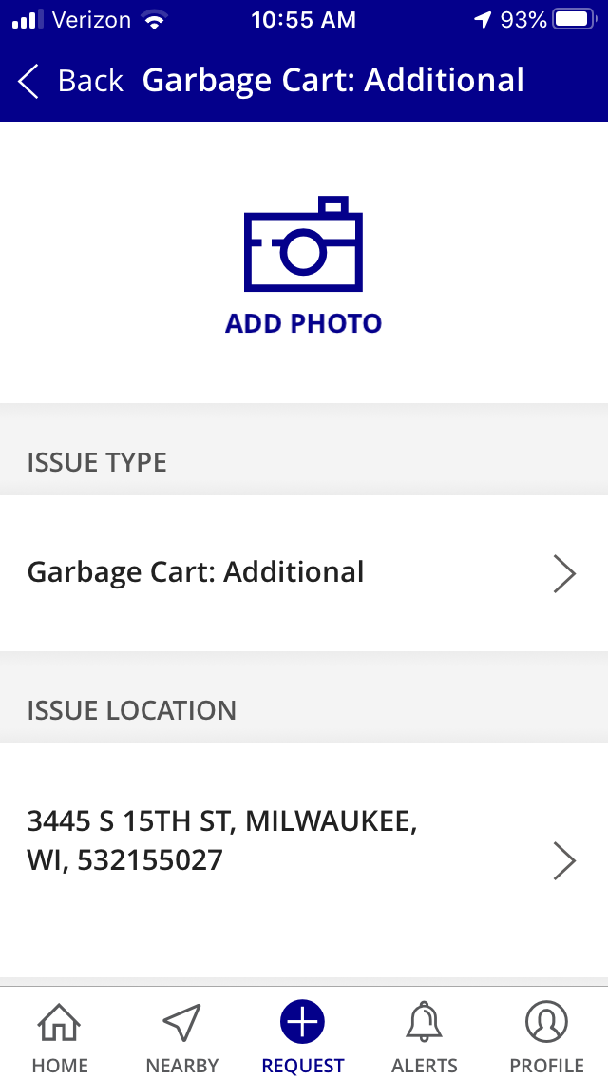
Tap +Request Service
Select the type of request desired and then simply complete the fields to enter the information needed for the City to fulfill the request.
It’s easy and intuitive to add photos.

Slide 16
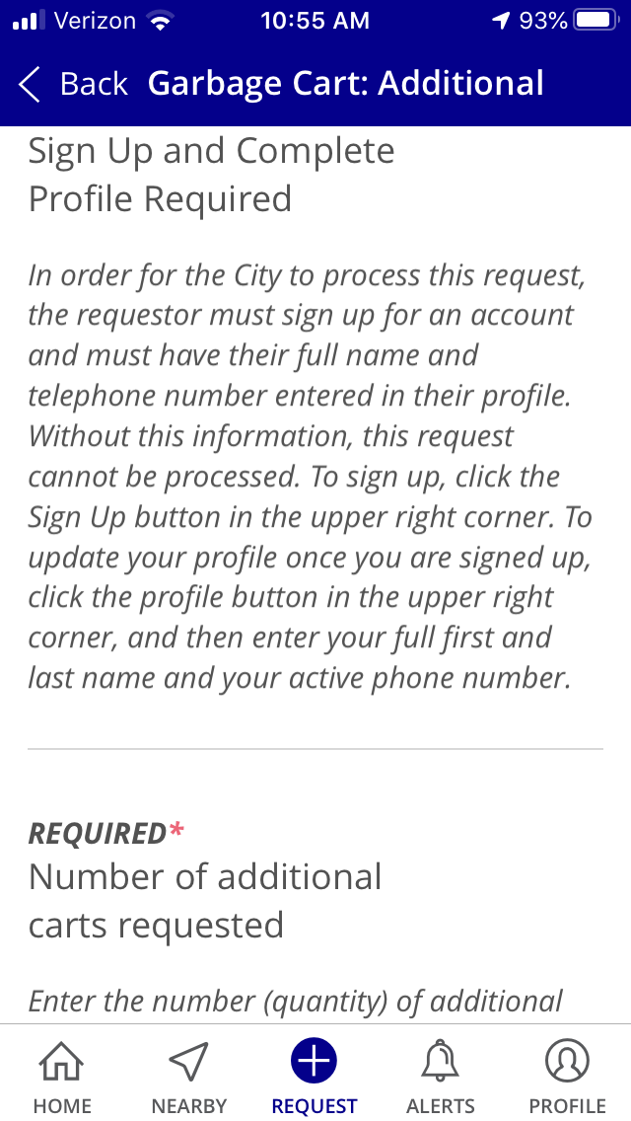
Tap +Request Service
Select the type of request desired and then simply complete the fields to enter the information needed for the City to fulfill the request.
Helpful information about requests and the information necessary to fulfill them is displayed.

Slide 17
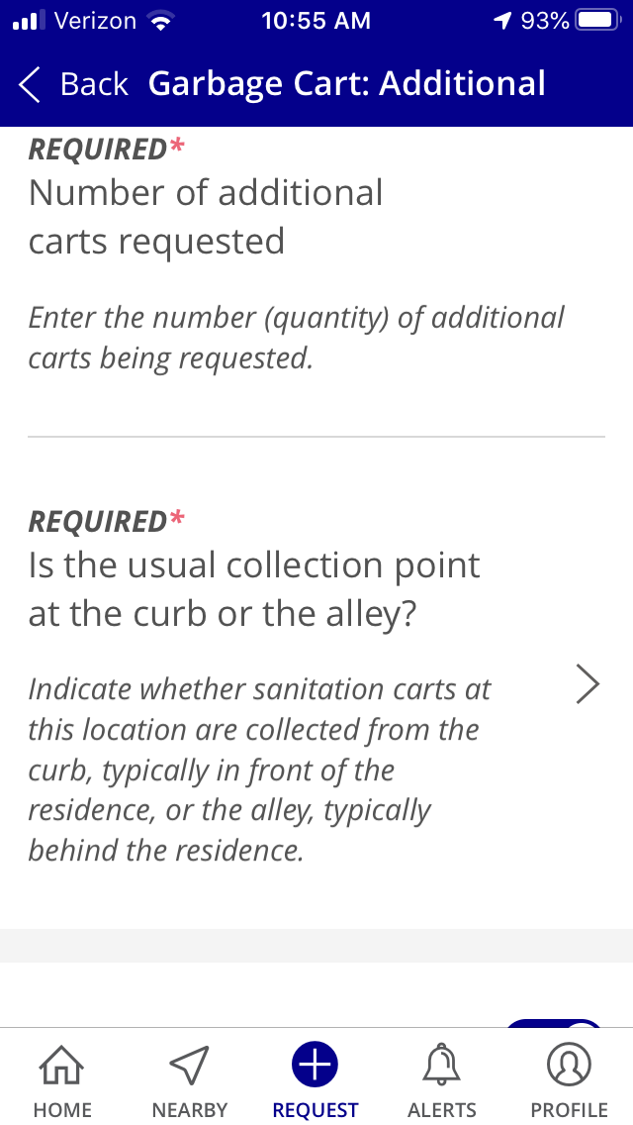
Tap +Request Service
Select the type of request desired and then simply complete the fields to enter the information needed for the City to fulfill the request.
Different requests need different information – scrolling down reveals necessary fields.

Slide 18
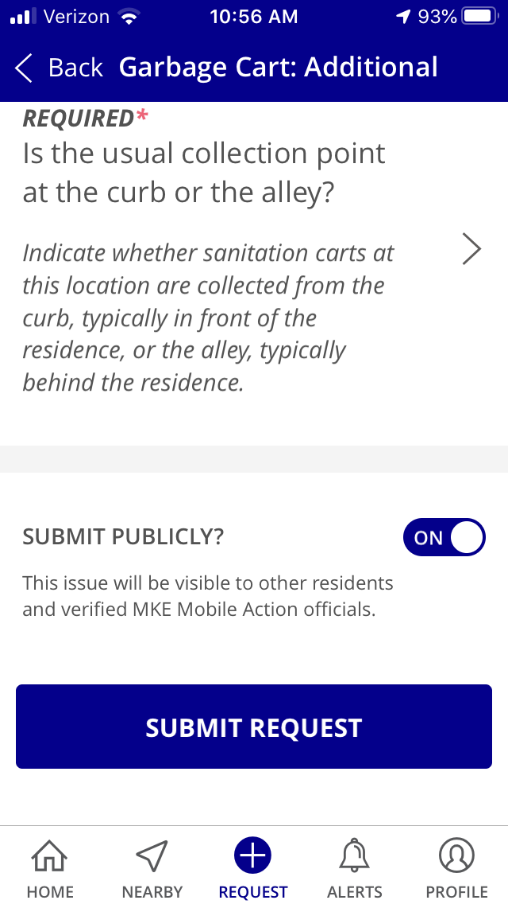
Tap +Request Service
Select the type of request desired and then simply complete the fields to enter the information needed for the City to fulfill the request.
For many request types, users can opt to have the request be private, visible only to the user and City staff.

Slide 19
Tap +Request Service
Select the type of request desired and then simply complete the fields to enter the information needed for the City to fulfill the request.
Users get submittal confirmation email messages, as well as email notification of the City’s receipt of their requests.

Slide 20
Home Screen: Tap View Requests
You can view currently-processing requests in a list or map format.

Slide 21
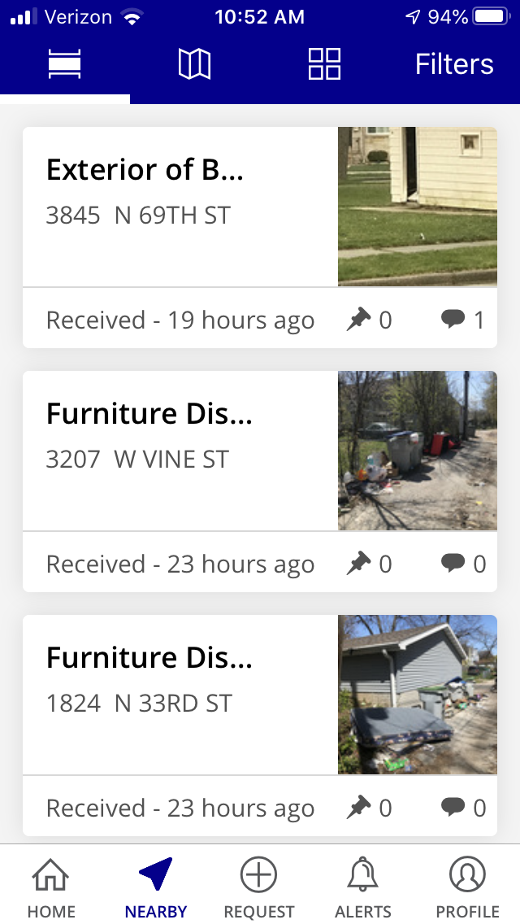
Home Screen: Tap View Requests
You can view currently-processing requests in a list or map format.

Slide 22
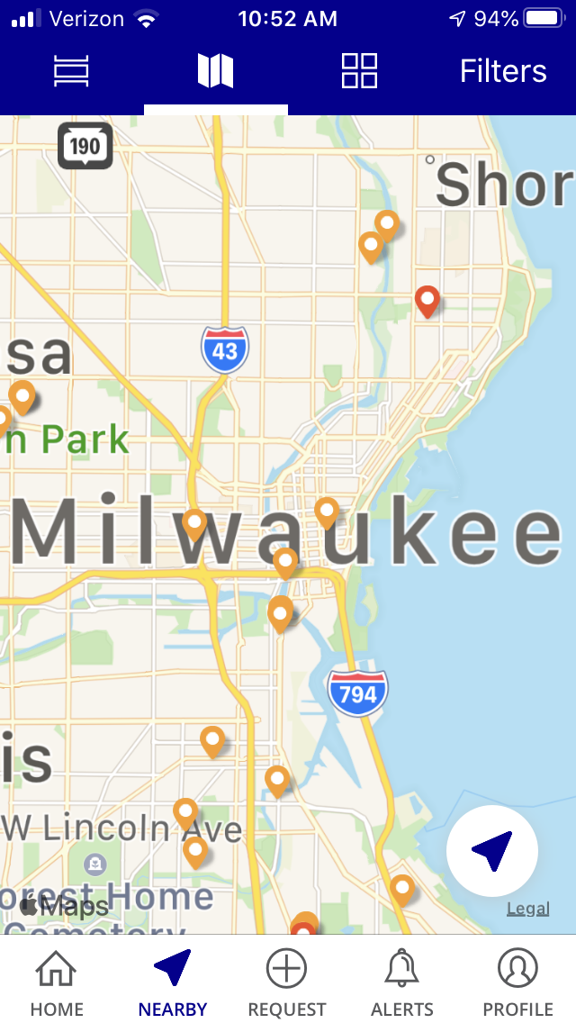
Home Screen: Tap View Requests
You can view currently-processing requests in a list or map format.

Slide 23
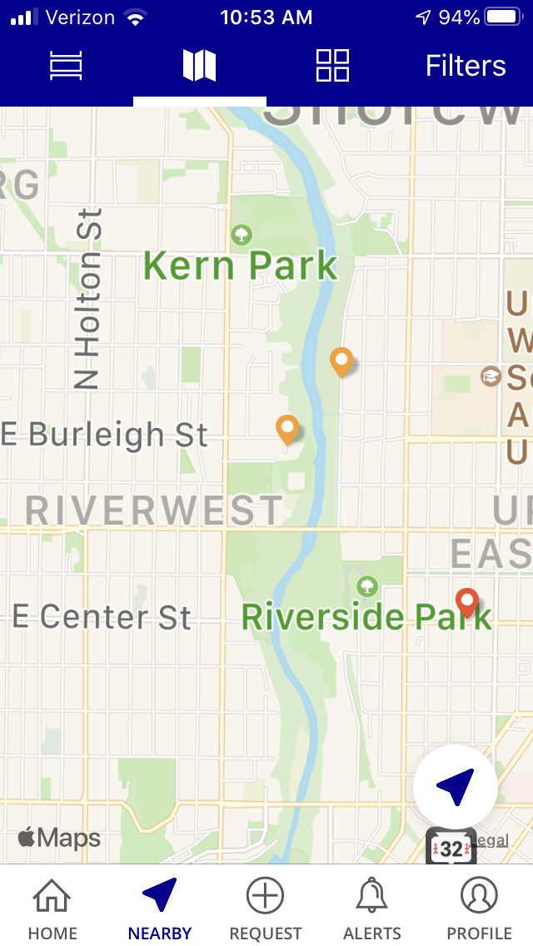
Home Screen: Tap View Requests
You can view currently-processing requests in a list or map format.

Slide 24
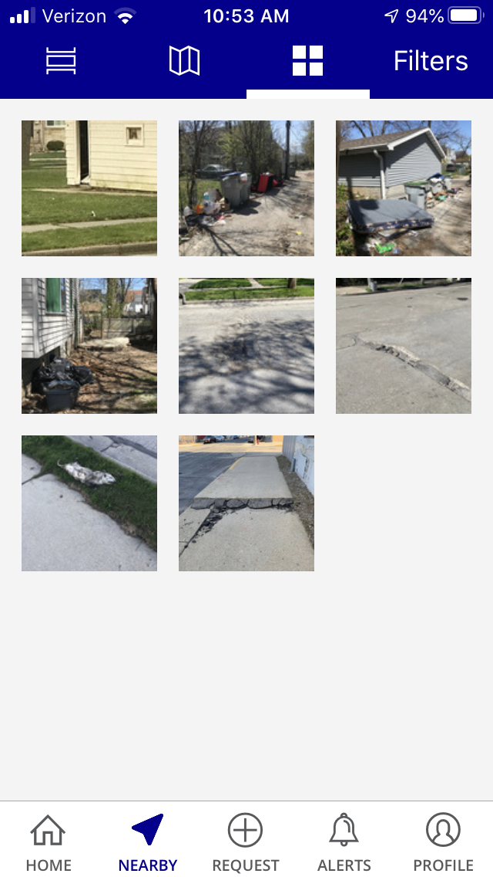
Home Screen: Tap View Requests
You can also view currently-processing requests which have photos associated with them by those images.

Slide 25
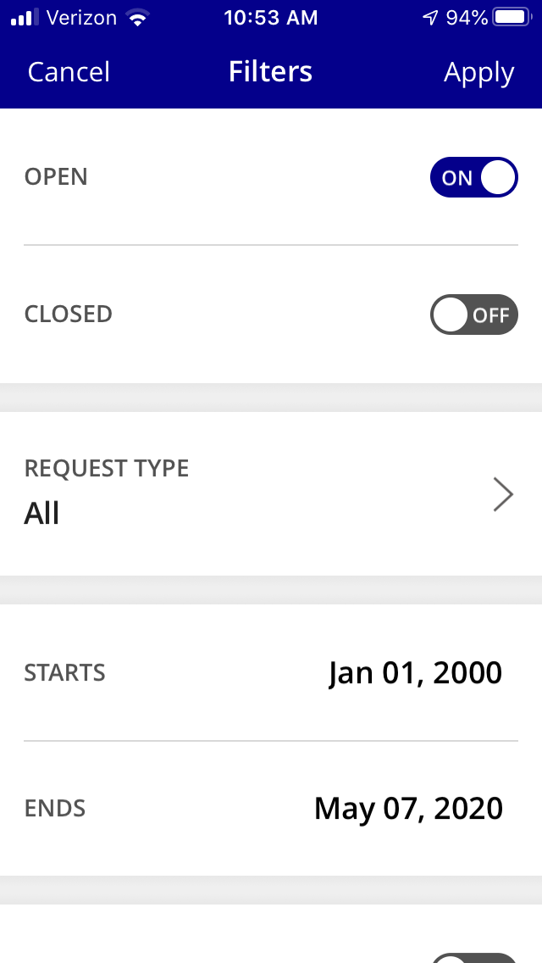
Home Screen: Tap View Requests
You can also narrow down the currently-processing requests you wish to view by using filters – you can filter by status, type, and dates, and see all public requests or just your own.

Slide 26
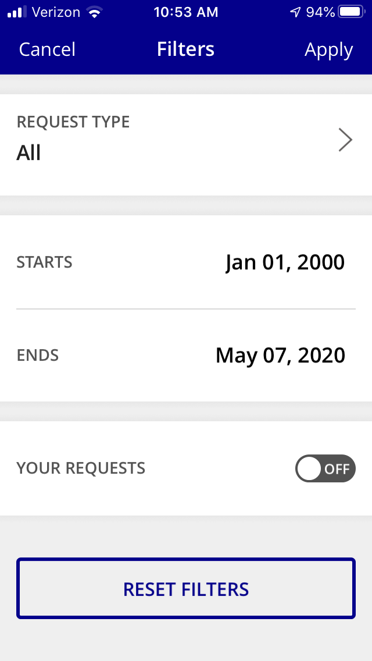
Home Screen: Tap View Requests
You can also narrow down the currently-processing requests you wish to view by using filters – you can filter by status, type, and dates, and see all public requests or just your own.

Slide 27
Home Screen: Tap call 286-city
Tapping this button enables users to quickly and easily call 286-CITY (2489) for help and information.

Slide 28
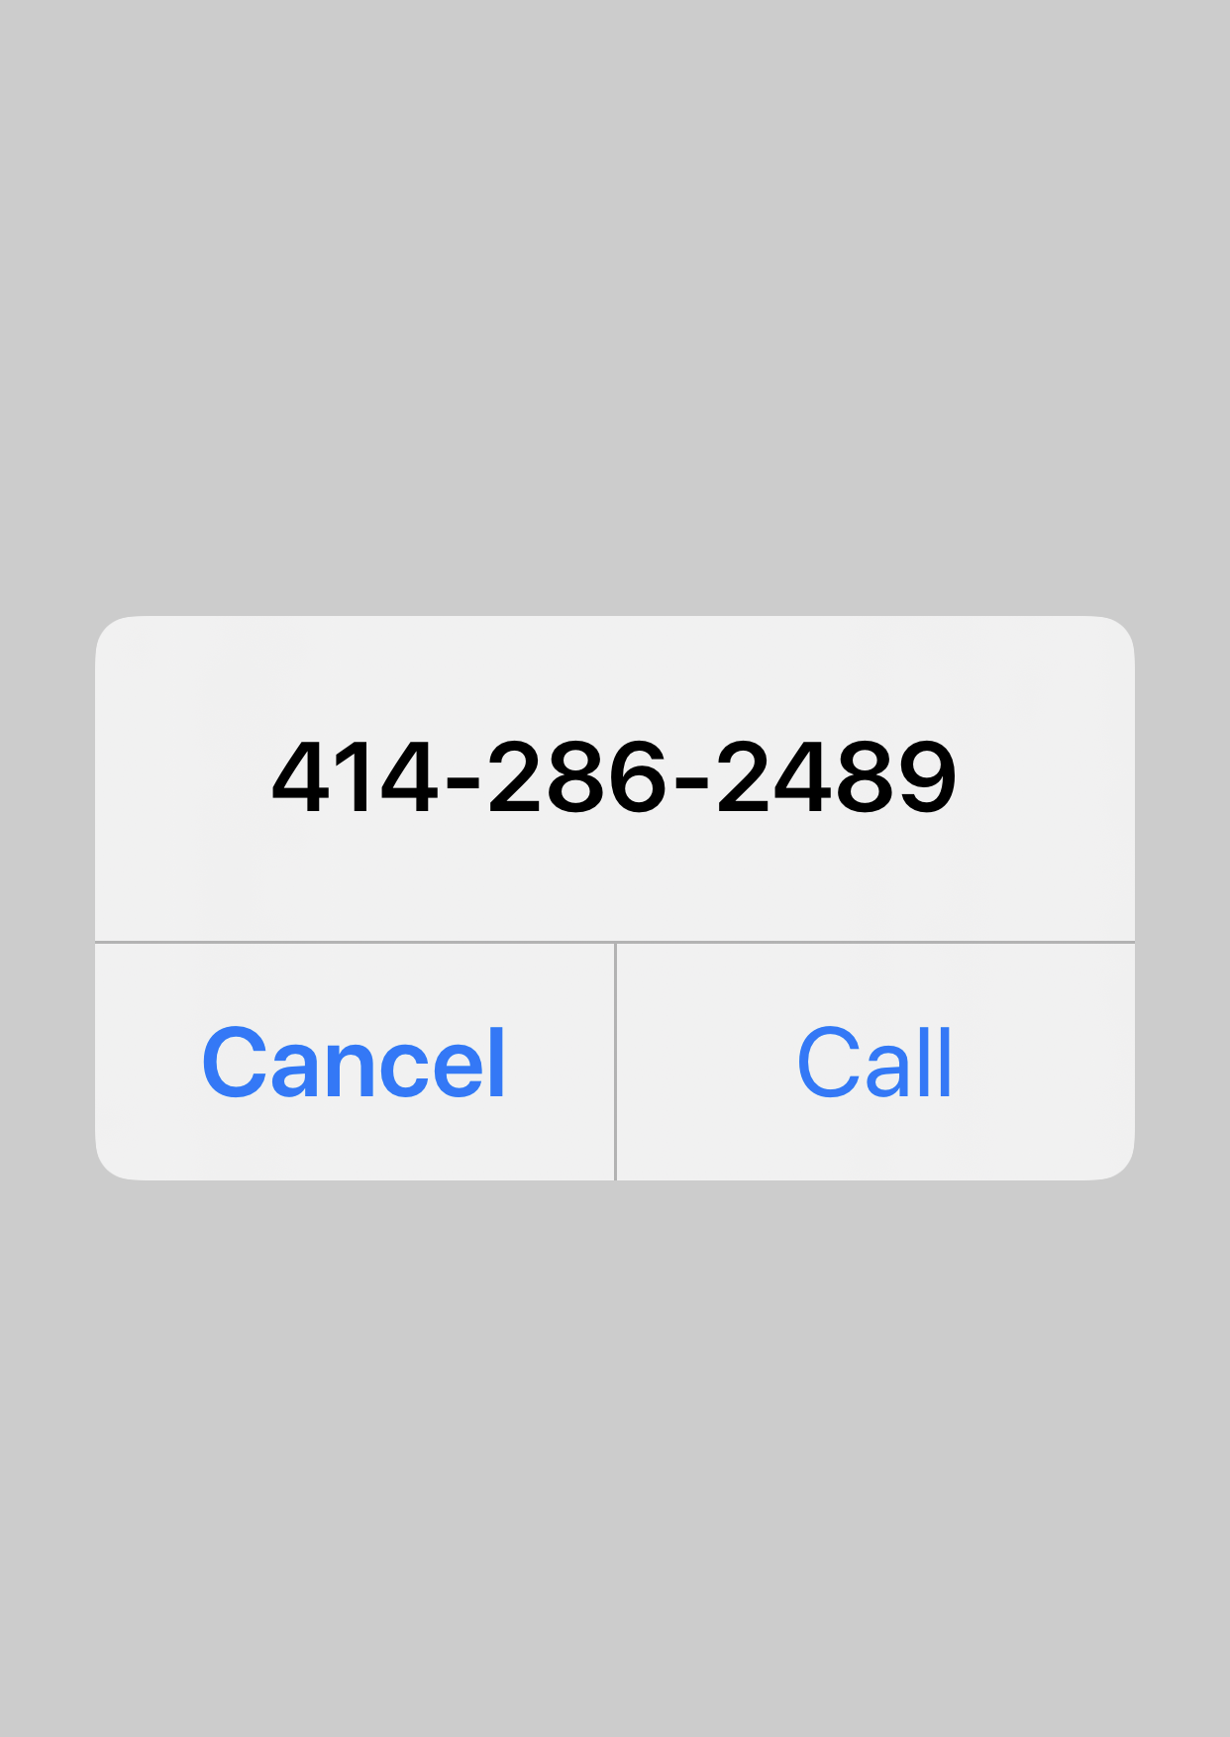
Home Screen: Tap call 286-city
Tapping the Call 286-CITY button launches the mobile device’s phone application and enables the user to quickly dial the City for assistance.

Slide 29
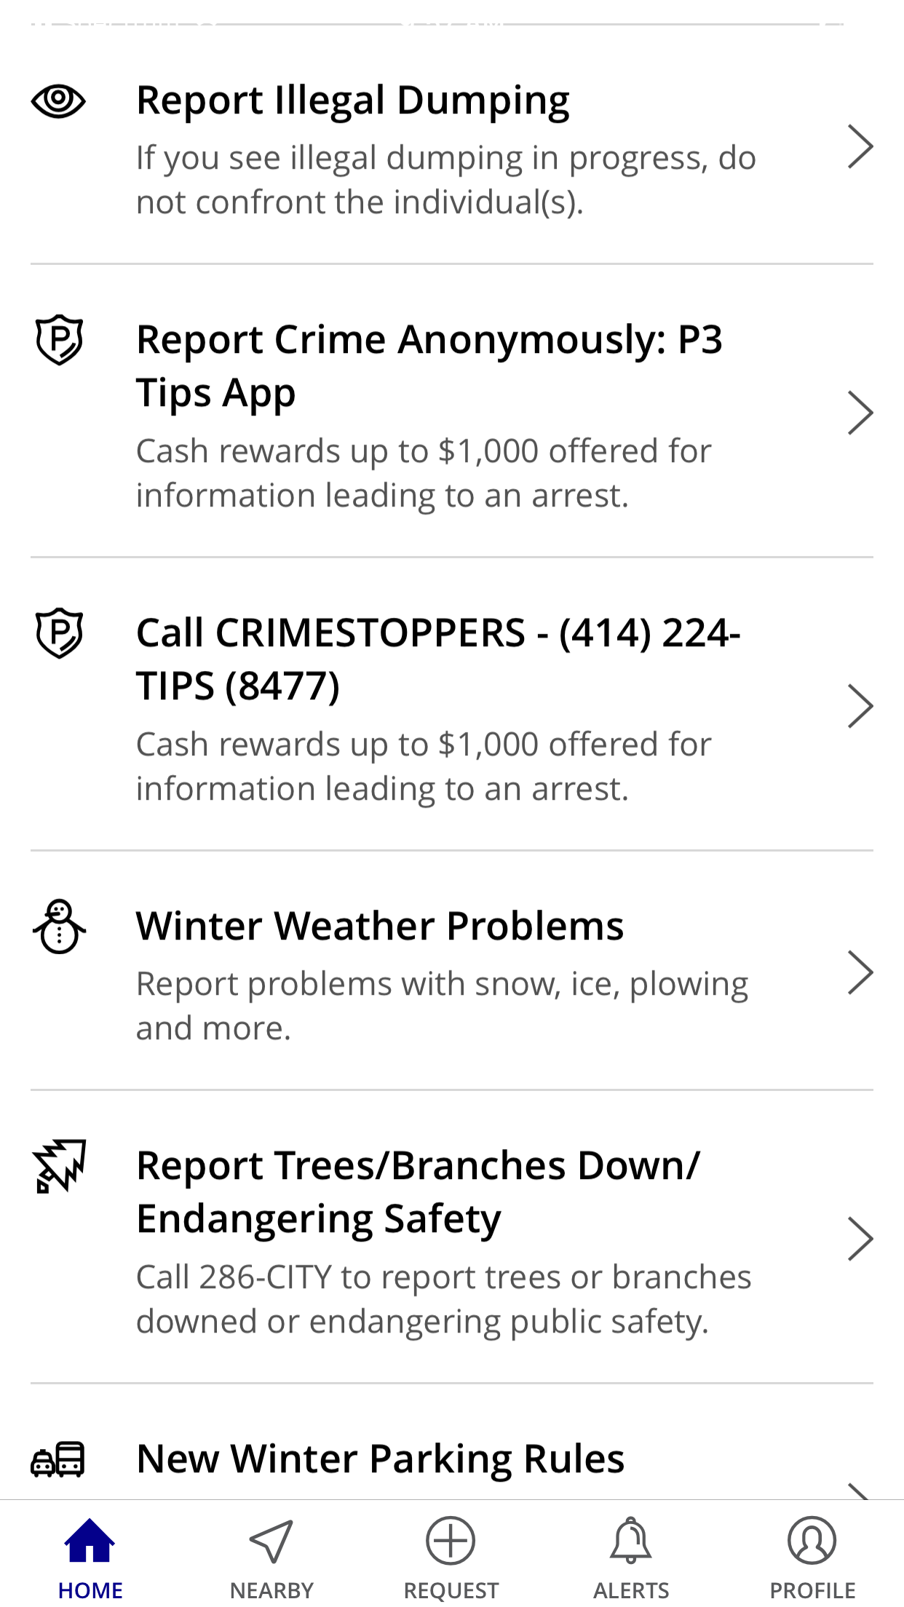
Home Screen: current vital information
Current information vital to public well-being appears at the top of the Home Screen. UCC Management can quickly and easily update the Home Screen to accommodate quickly-changing circumstances.

Slide 30
Home Screen: Tap report illegal dumping
Quickly access the City’s Illegal Dumping webpage to report illegal dumping.
A responsive page is coming soon to make this even easier!

Slide 31
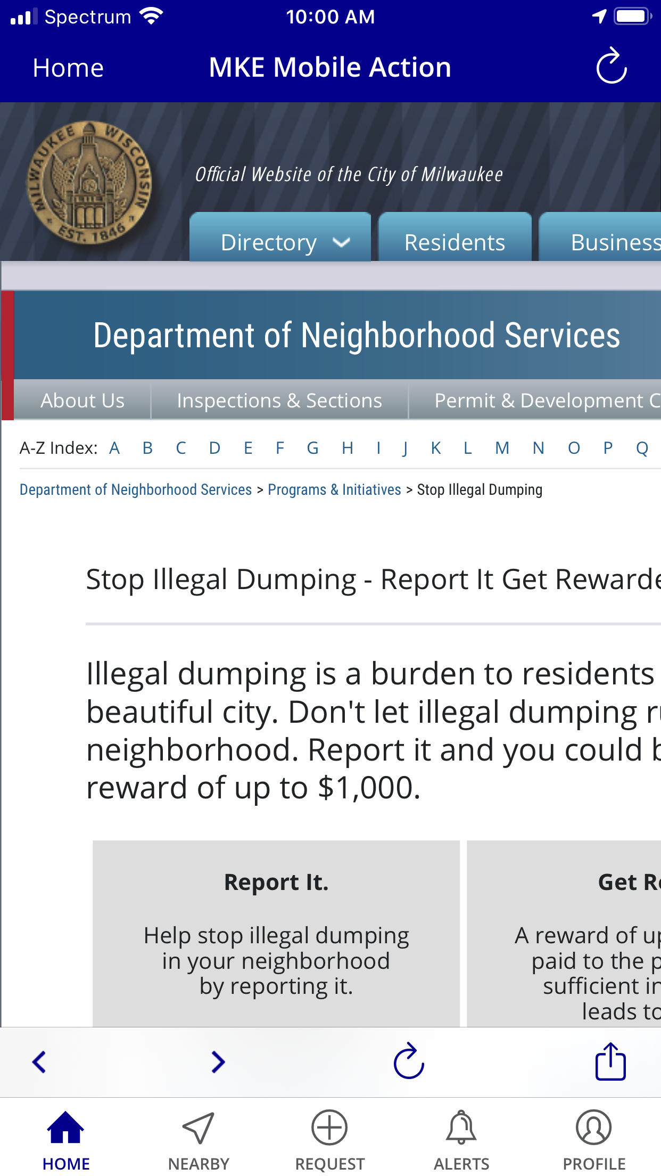
Home Screen: Tap report illegal dumping
Quickly access the City’s Illegal Dumping webpage to report illegal dumping.
A responsive page is coming soon to make this even easier!

Slide 32
Home Screen: Report Crime Anonymously
Quickly access the Milwaukee Police Department’s P3 Tips App or dial 224-TIPS – cash rewards up to $1,000 are offered for information leading to an arrest!

Slide 33
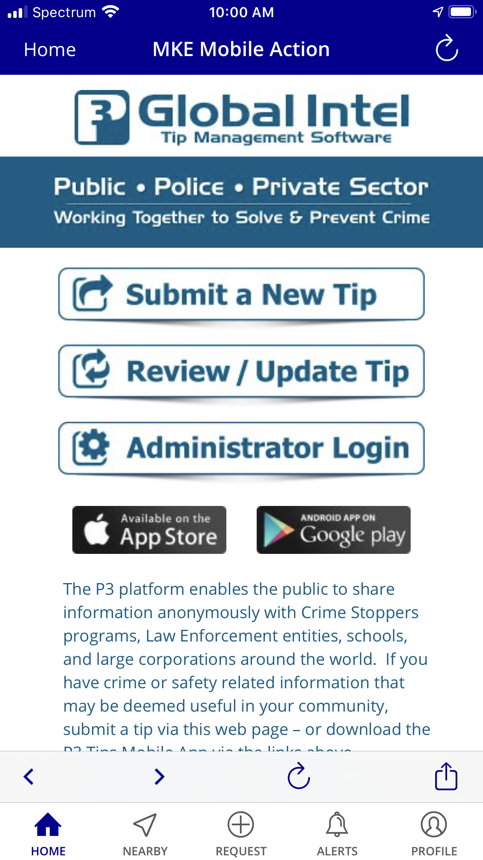
Home Screen: Report Crime Anonymously
Quickly access the Milwaukee Police Department’s P3 Tips responsive web-based application, which opens seamlessly in MKE Mobile’s integrated mobile browser for continuity of user experience.

Slide 34
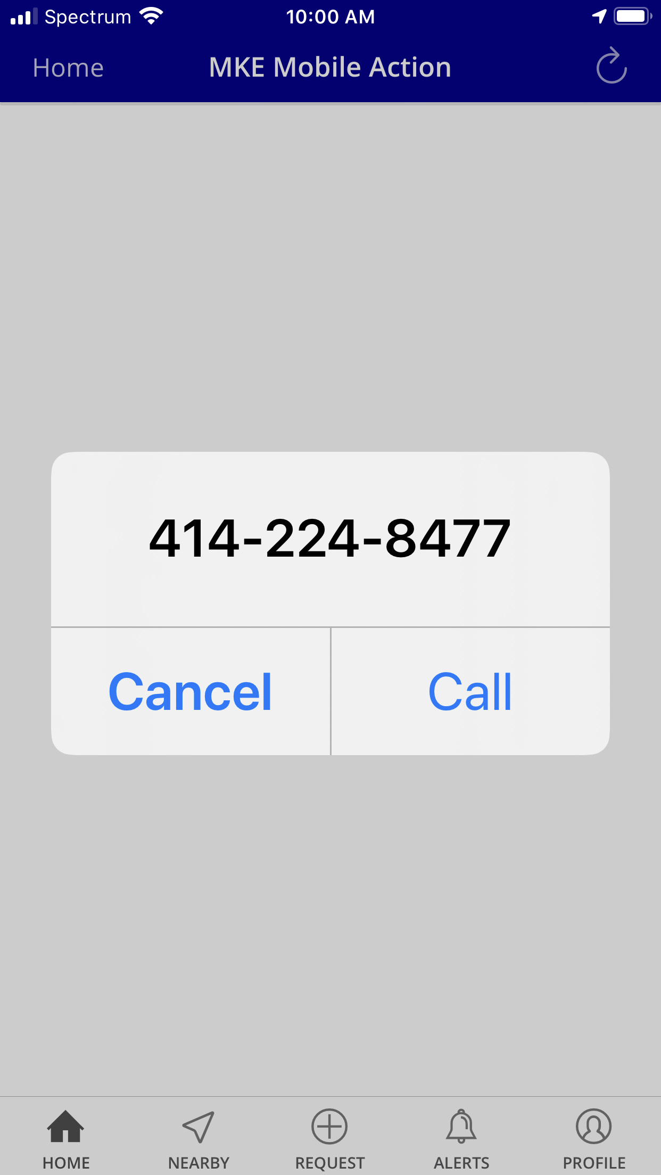
Home Screen: Report Crime Anonymously
The call widget launches the user’s mobile device’s phone application, enabling the user to quickly call CrimeStoppers to provide anonymous tips.

Slide 35
Home Screen: tap a current “hot” request category
Request categories relevant to current conditions appear on the homescreen for easy access.

Slide 36
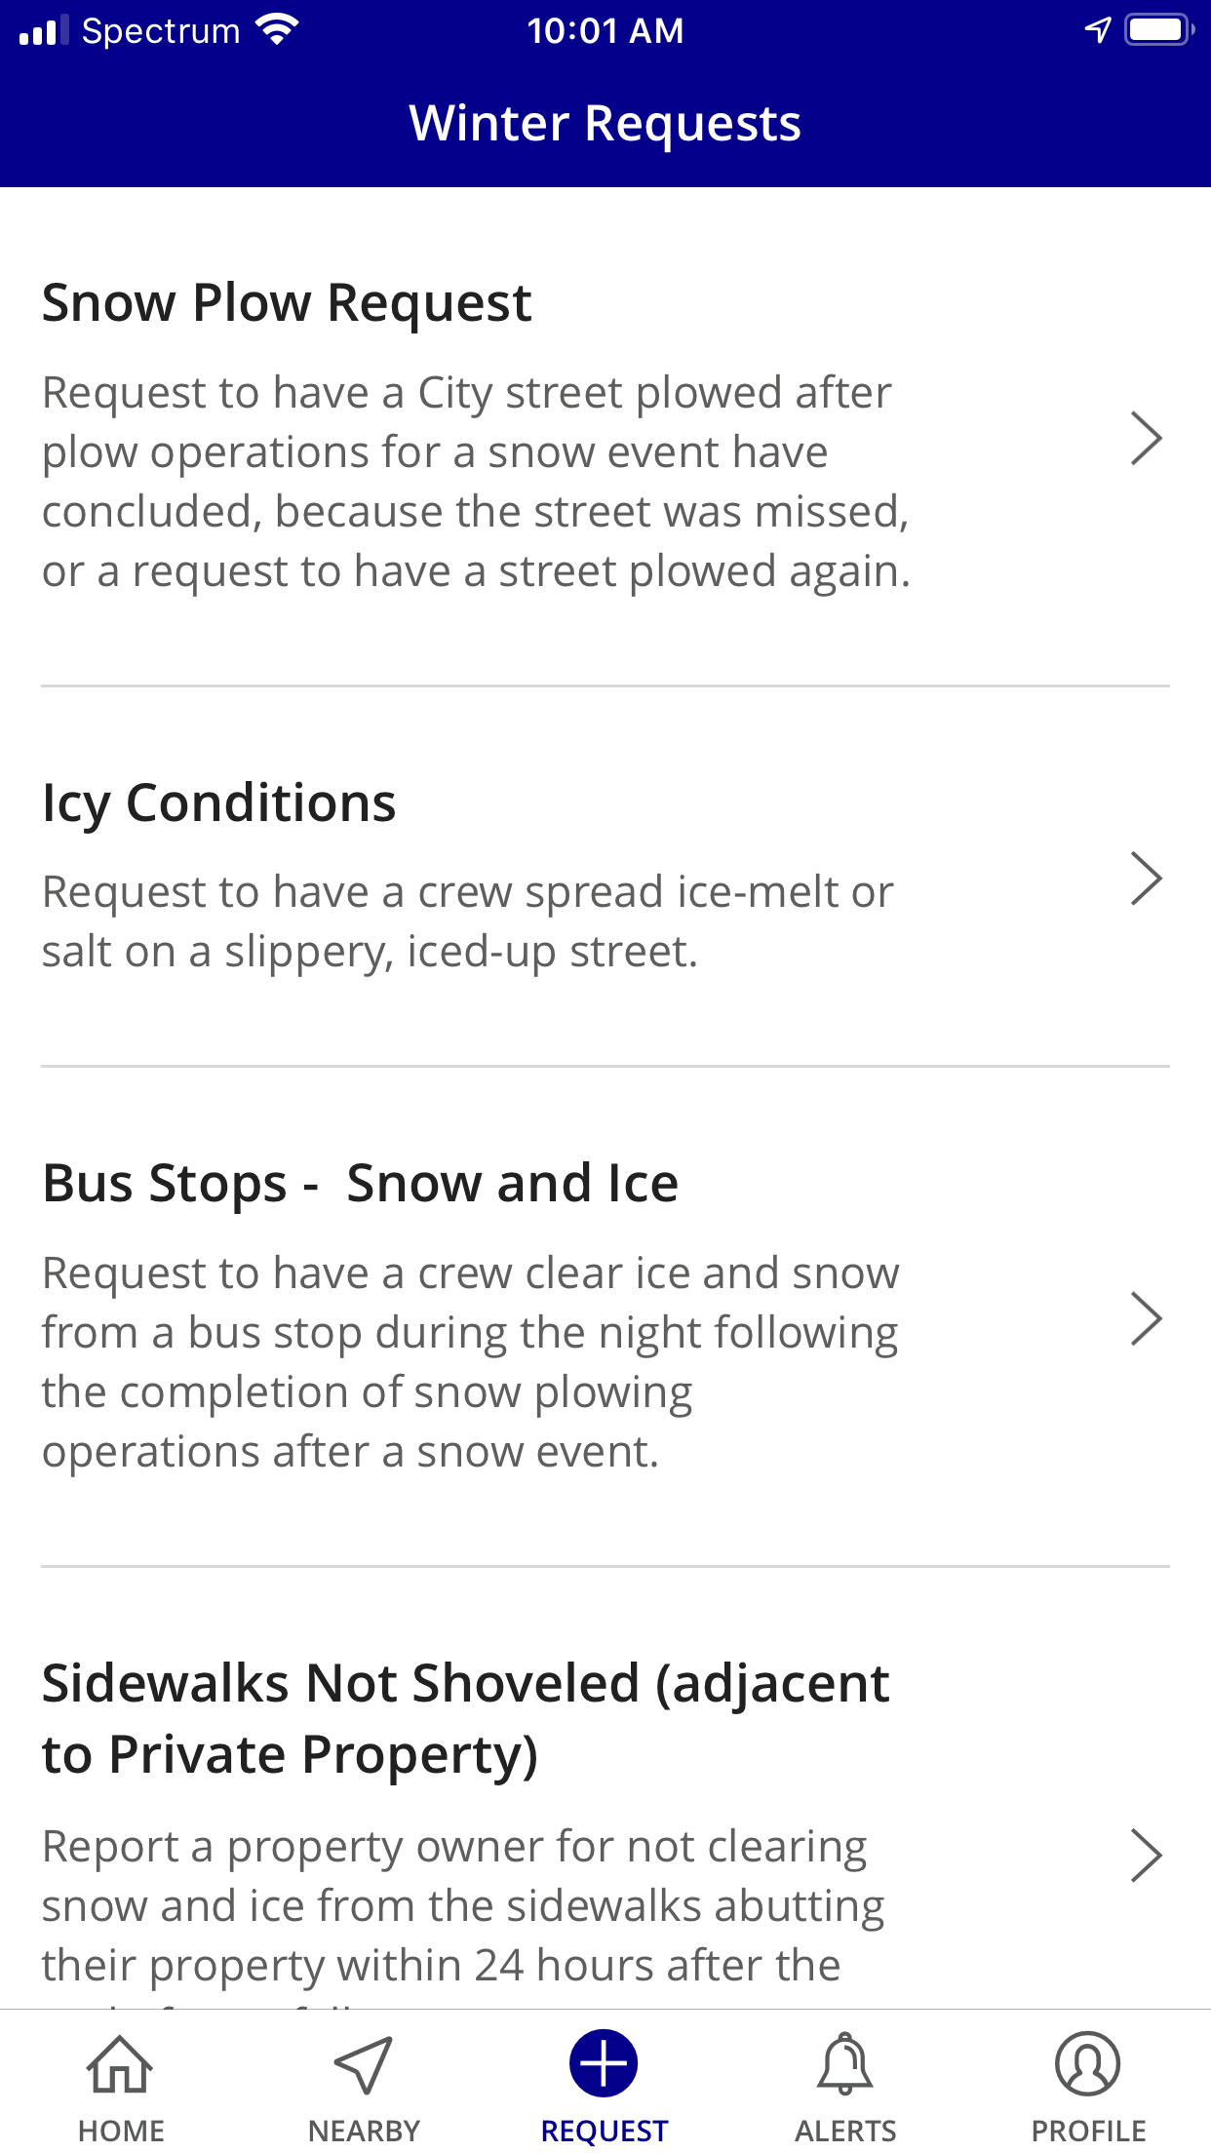
Home Screen: tap a current “hot” request category
Request categories relevant to current conditions appear on the homescreen for easy access.
UCC Management updates these for current seasons and events.

Slide 37
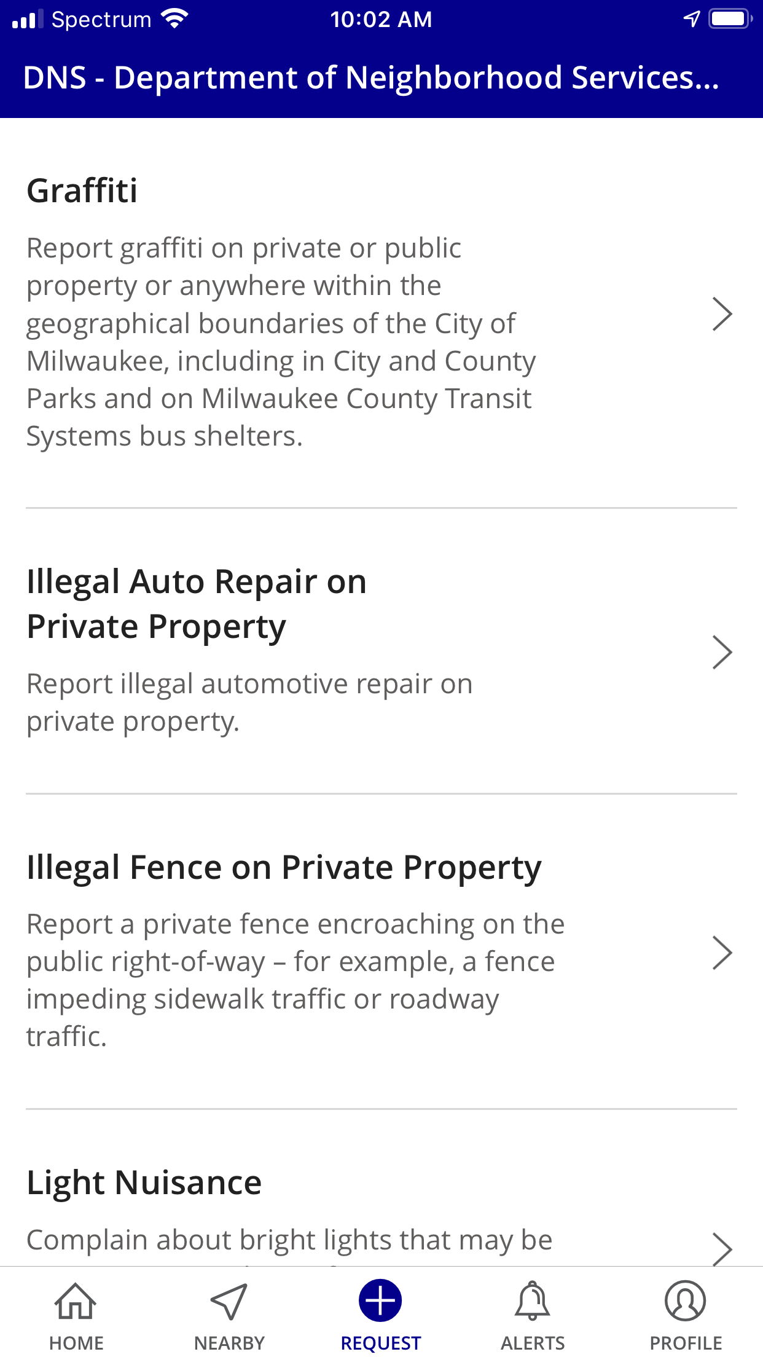
quickly start a new request
Footer buttons get you around the app quickly. The + Request button launches a new request – pull down to search or scroll down to select from categories.

Slide 38
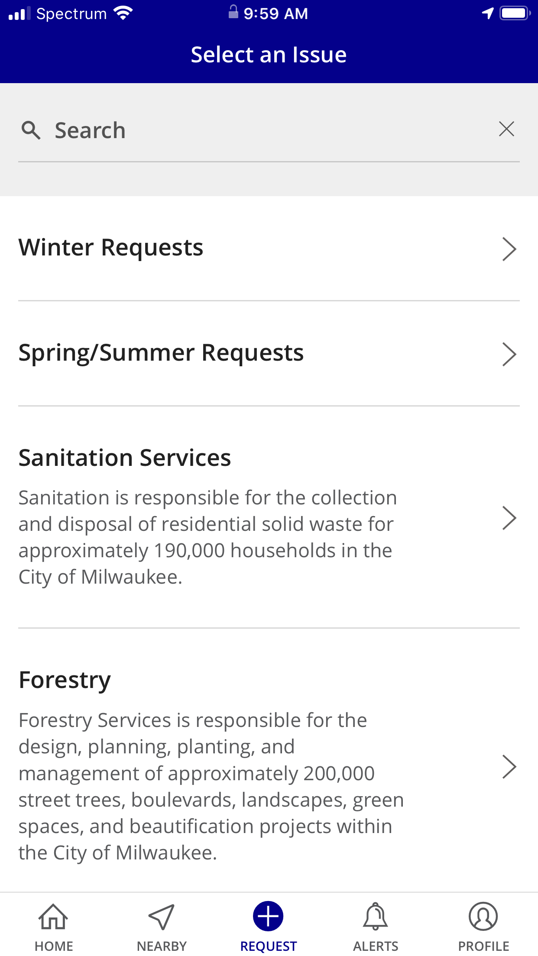
quickly start a new request
Footer buttons get you around the app quickly. The + Request button launches a new request – pull down to search or scroll down to select from categories.

Slide 39
Create a profile & get notified
Register with an email address or with your FaceBook account and enable notifications to be sent to you by email and/or to appear on your mobile device.

Slide 40
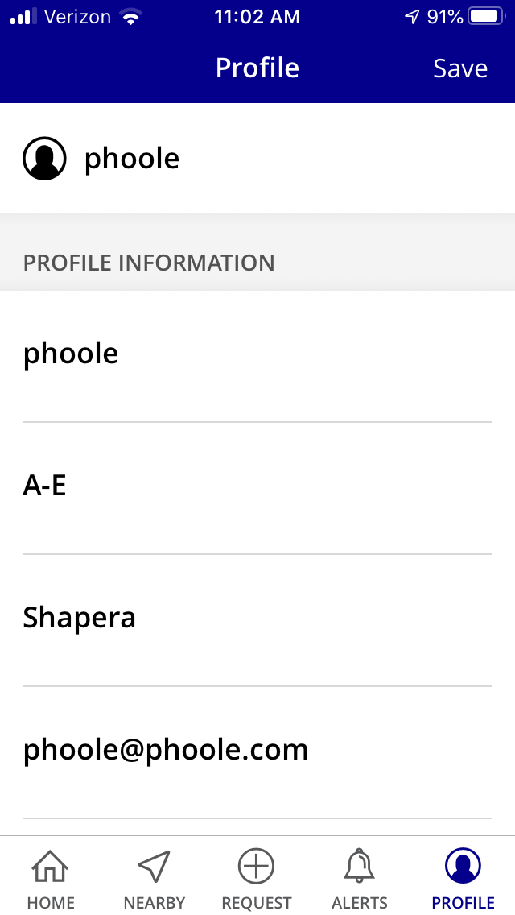
Create a profile & get notified
Register with an email address or with your FaceBook account and enable notifications to be sent to you by email and/or to appear on your mobile device.

Slide 41
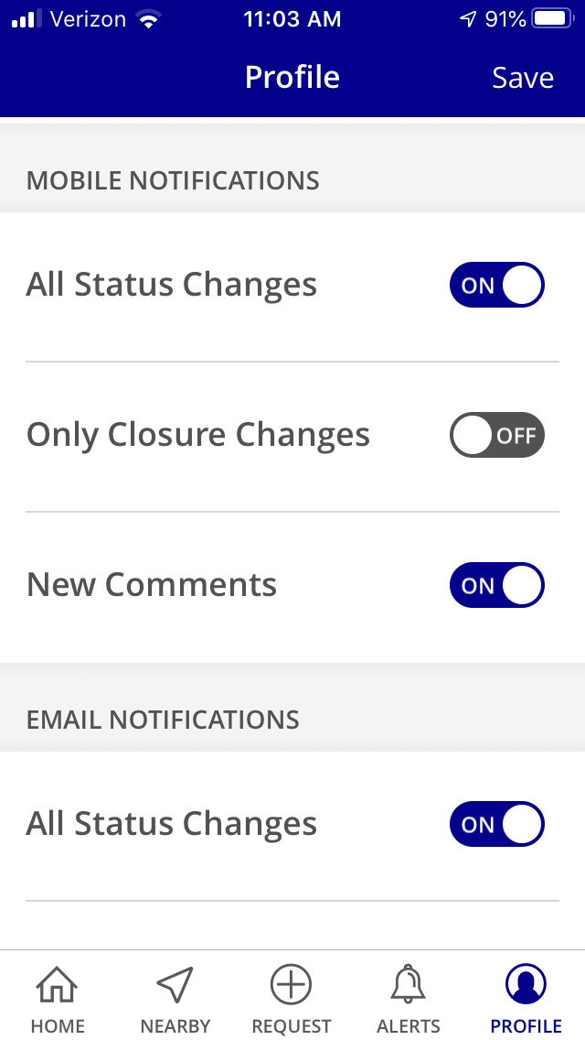
Create a profile & get notified
Register with an email address or with your FaceBook account and enable notifications to be sent to you by email and/or to appear on your mobile device.

Slide 42
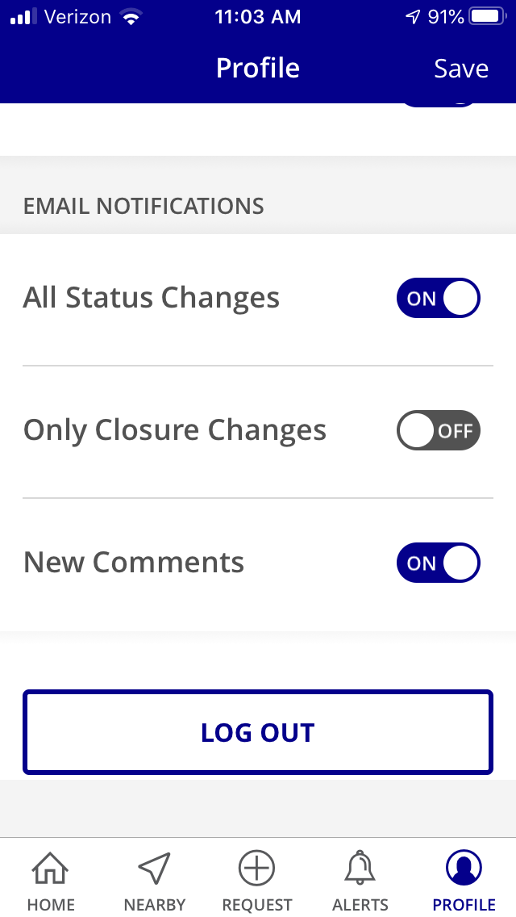
Create a profile & get notified
Register with an email address or with your FaceBook account and enable notifications to be sent to you by email and/or to appear on your mobile device.

Slide 43
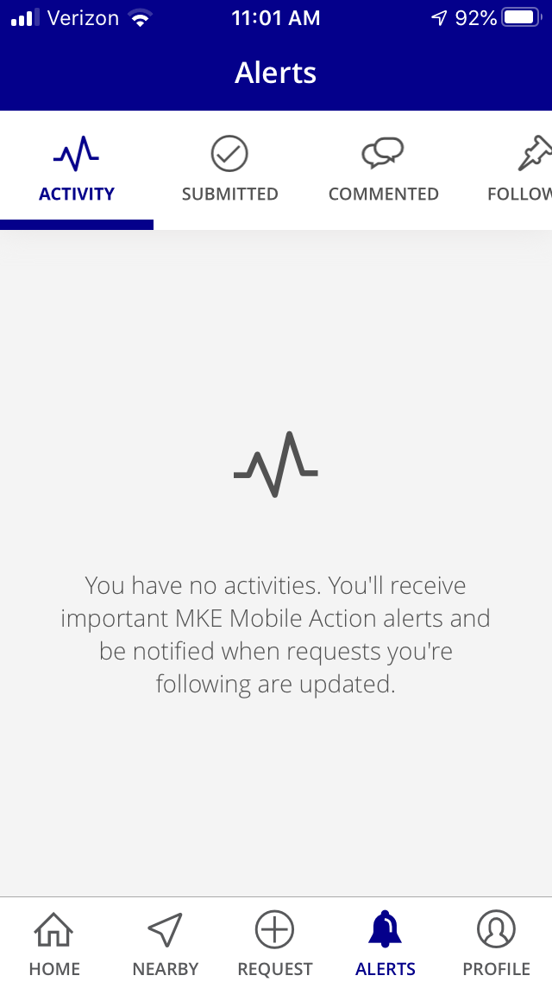
Create a profile & get notified
Register with an email address or with your FaceBook account and enable notifications to be sent to you by email.
Users get alerts when requests they’ve submitted, commented on, or are following get updated.

Slide 44
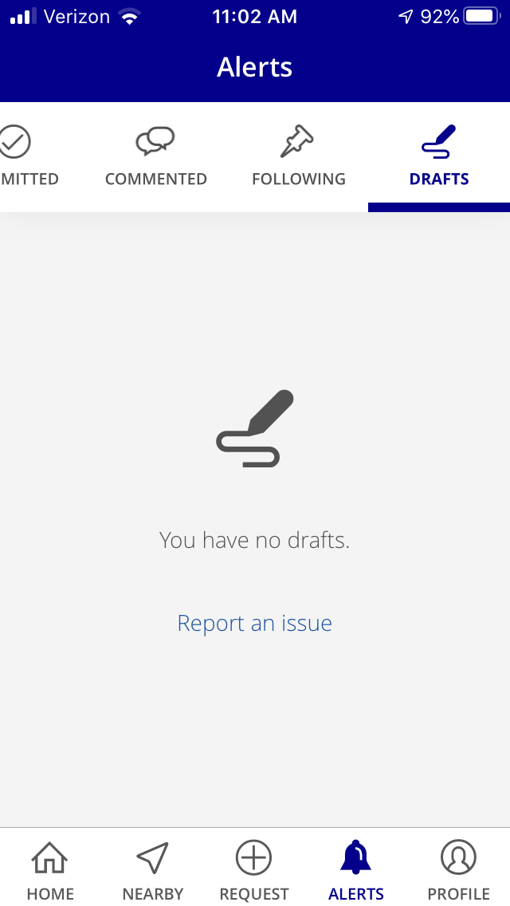
Create a profile & save drafts
Register with an email address or with your FaceBook account and draft requests can be saved until they’re ready to submit.

Slide 45

I’m here to help!
Ann-Elizabeth “A-E” Shapera
Unified Call Center (UCC) Operations Manager
(414) 286-CITY (2489)
UCCWebHelp@milwaukee.gov

